Slide 1
Shipement Price Prediction

Slide 2
Design Project
Review II
Guided By :-
Prof.Mandar Diwakar
Name | Roll No. | PRN | Email - Id
Amey Bhirange | 373005 | 22110073 | amey.22110073@viit.ac.in
Saloni Dhurandhar | 373012 | 22110034 | saloni.22110034@viit.ac.in
Nikhil Dongare | 373015 | 22110412 | nikhil.22110412@viit.ac.in
Shreyas Kharche | 373023 | 22110063 | shreyas.22110063@viit.ac.in

Slide 3
Table of contents
01
02
03
Problem Statement
Introduction
Motivation
04
05
Literature Survey
Gap Analysis

Slide 4
Table of contents
06
07
08
Objectives
Scope of Work
Requirements
09
10
System Architecture
Conclusion

Slide 5
01
Problem Statement

Slide 6
Problem Statement
To provide a methodological approach to analyze the ongoing trends and predicting the future price of shipment packages based on various factors which affect the pricing. This prediction is to be done using the machine learning models.

Slide 7
02
Introduction

Slide 8
Introduction
Shipment price predictive forecasting uses statistical techniques and machine learning to predict future prices based on historical data. It assists in understanding past trends, enhancing decision-making for cash flow, risk assessment, capacity planning, and meeting customer demands in the supply chain.

Slide 9
03
Motivation
You can enter a subtitle here if you need it

Slide 10
Motivation
Vital SCM Growth: SCM is crucial for industries, with rapid growth due to increasing product demand.
Shipment Forecasting's Role: Shipment Forecasting reveals supply chain insights, enabling data-driven decisions.
3. Resilience and Future Focus: It helps SCM overcome challenges, adapt to disruptions, and thrive in a data-driven future.

Slide 11
04
Literature Survey

Slide 12
Literature Survey
Research Paper | Name of Author | Methodology | Link
Shipment Price Forecasting | Mohamed Illiyas I | Forecasting helps predict short and long-term prices and their underlying drivers. Customer satisfaction is crucial for growth. To keep customers happy, provide the right product at the right time, avoiding overcharging due to demand and supply. Price forecasting minimizes unnecessary shipping costs, lowering product prices and increasing customer satisfaction. | https://www.linkedin.com/posts/mohamed-illiyas_supply-chain-shipment-pricing-forecasting-activity-6880766053572599808-zu0R/
Predictive Big Data Analytics for Supply Chain | Mahya Seyedan & Fereshteh Mafakheri | Big data analytics (BDA) is increasingly important in supply chain management (SCM), with applications including customer behavior analysis, trend analysis, and demand prediction. This survey categorizes BDA applications for supply chain demand forecasting into various methods and points out a research gap in applying BDA to closed-loop supply chains (CLSCs), offering suggestions for future research. | https://journalofbigdata.springeropen.com/articles/10.1186/s40537-020-00329-2

Slide 13
Research Paper | Name of Author | Methodology | Link
IRAS | Karthik Sonti, Daisuke Tsukamoto | Accenture Intelligent Revenue and supply chain (IRAS) Management is the service developed by Accenture in partnership with Amazon. This platform integrates insights generated by machine learning (ML) and artificial intelligence (AI) models into an enterprise’s technical and business ecosystems. | https://aws.amazon.com/blogs/apn/optimizing-supply-chains-through-intelligent-revenue-and-supply-chain-iras-management/
Forecasting the Spot Price of P1A Shipping Route | Panagiota Giannakopoulou | This project has two main objectives. First, it aims to identify the financial and shipping measures that significantly impact the estimation of the daily spot voyage time charter price for the P1A Panamax shipping route, as reported by the Baltic Exchange in London. Second, it seeks to evaluate the predictive capabilities of multivariate feature models and single-variable time series models to forecast the future voyage time charter price for the P1A shipping route. | Forecasting the Spot Price of P1A Shipping Route | IEEE Conference Publication | IEEE Xplore

Slide 14
Research Paper | Name of Author | Methodology | Link
Application of machine learning techniques for supply chain demand forecasting | Real Carbonneau Kevin Laframboise Rustam Vahidov | This study explores supply chain collaboration challenges and uses advanced machine learning methods, like neural networks and recurrent neural networks, to forecast distorted demand (the bullwhip effect). Traditional methods, such as naïve forecasting and regression, are compared. Results indicate that advanced techniques perform well but not significantly better than regression models. | https://www.sciencedirect.com/science/article/abs/pii/S0377221706012057

Slide 15
05
Gap Analysis

Slide 16
Gap Analysis
1. Limited Utilization of Advanced Techniques:
Gap: Many SCM organizations still rely on outdated forecasting methods, missing out on the benefits of advanced statistical techniques and machine learning.
Opportunity: Embracing predictive analytics can improve shipment forecast accuracy, enabling better-informed decisions.
2. Capacity and Workflow Optimization:
Gap: Capacity planning and workflow optimization often depend on static historical data and rule-based systems that don't adapt in real-time.
Opportunity: Shipment forecasting offers dynamic insights for agile and efficient operations, bridging this gap.

Slide 17
06
Objectives

Slide 18
Objectives
The primary goal of this project is to develop an advanced shipment forecasting system tailored to the needs of the supply chain management (SCM) sector. This system aims to empower organizations by helping them adapt to -
1. supply chain variations
2. increase logistic efficiency
3. make data-driven decisions
By implementing advanced analytics, the project seeks to support industry growth, mitigate financial risks, and ultimately enhance operational excellence, thereby ensuring the competitiveness of organizations in the SCM industry.

Slide 19
Scope of Work
07

Slide 20
Scope of Work
Platform Development
Create a user-friendly web-based platform for Shipment Price Prediction
IRAS empowers supply chain operators with real-time data and forecasting models.
IRAS, or Intelligent Revenue and Supply Chain Management, is a platform developed by Accenture in collaboration with Amazon that leverages machine learning and artificial intelligence to optimize supply chain operations.
Benchmarking
Products

Slide 21
Scope of Work
Business
Opportunity
Extending this technique to small businesses and logistics firms offers big opportunities, especially with the increasing demand for their products and services.
The final product is a service that provides small businesses with detailed information on what pricing to be given for packages in the shipping.
Final Product
Prototype

Slide 22
System Architecture
Start
Data for Prediction
Kaggle API
Data Preproccessing
Data Cleaning
Data from user
Start Application
Deploying to Cloud
Model Building
Feature Selection
Model Call for the user’s inputs
Predicted Value
End

Slide 23
Requirements
08

Slide 24
Requirements
Streamlit
ML Libraries & Frameworks
Jupyter Notebooks , VS code
S/W

Slide 25
09
Data Flow & UML

Slide 26
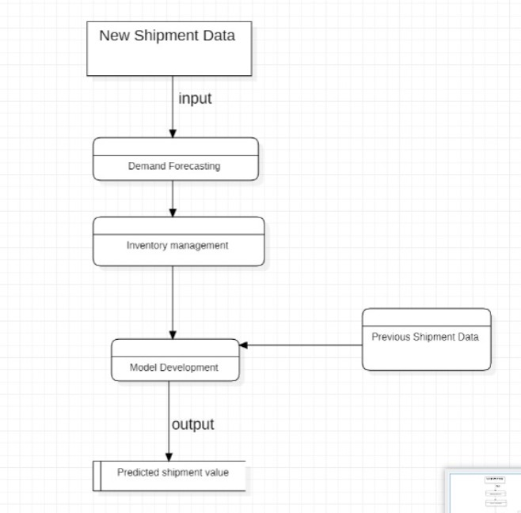

Slide 27
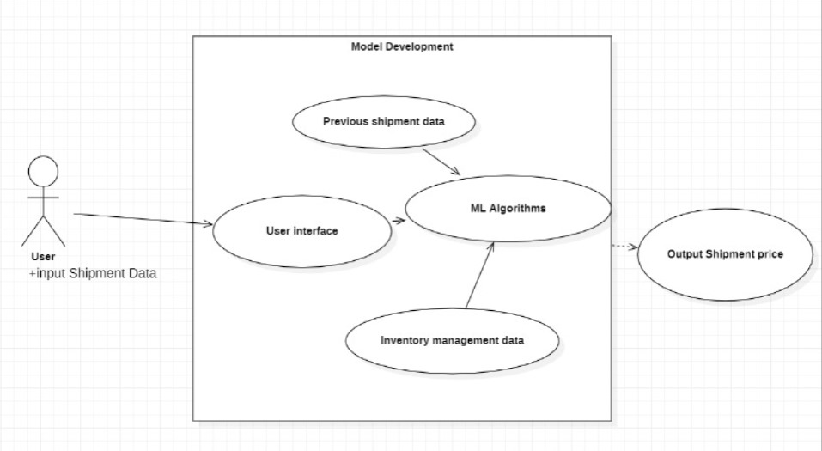

Slide 28
About the Dataset
This data set provides supply chain health commodity shipment and pricing data.
This dataset provides a more complete picture of global spending on specific health commodities.
Supply chain leaders may use this data to address supply chain difficulties, cut costs, and enhance service levels all at the same time.
This dataset is taken from U.S agency for international Development
Dataset Link :
https://data.usaid.gov/HIV-AIDS/Supply-Chain-Shipment-Pricing-Data/a3rc-nmf6

Slide 29
Dataset
Cleaned Dataset
New Data
Preprocessing
SPLIT
Train set
Test set
Hyperparameter Tunning
Best Model
ML Algorithms
Evaluate
Prediction

Slide 30
MODEL DEVELOPMENT
Feature Scaling :-
After pre-processing standard scalar is performed to scale down all the numeric features.
Even one hot encoding is also performed to convert the categorical features into numerical features
Model Selection :-
Different Regression models were compared and hyperparamater tuning was done via grid searchcv on the best performing one that is Light-gbm Regressor.

Slide 31
Prediction :-
The model is made in such a way to maximize the results and also other performance metrics so that the predictions are as accurate as possible
We have observed accuracy of 94.38 using Linear Regression algorithm.
Features such are ‘Days to Process ’, ’Line Item Insurance’ , ’Shipment Mode’, ‘Freight Cost’ are of importance.

Slide 32
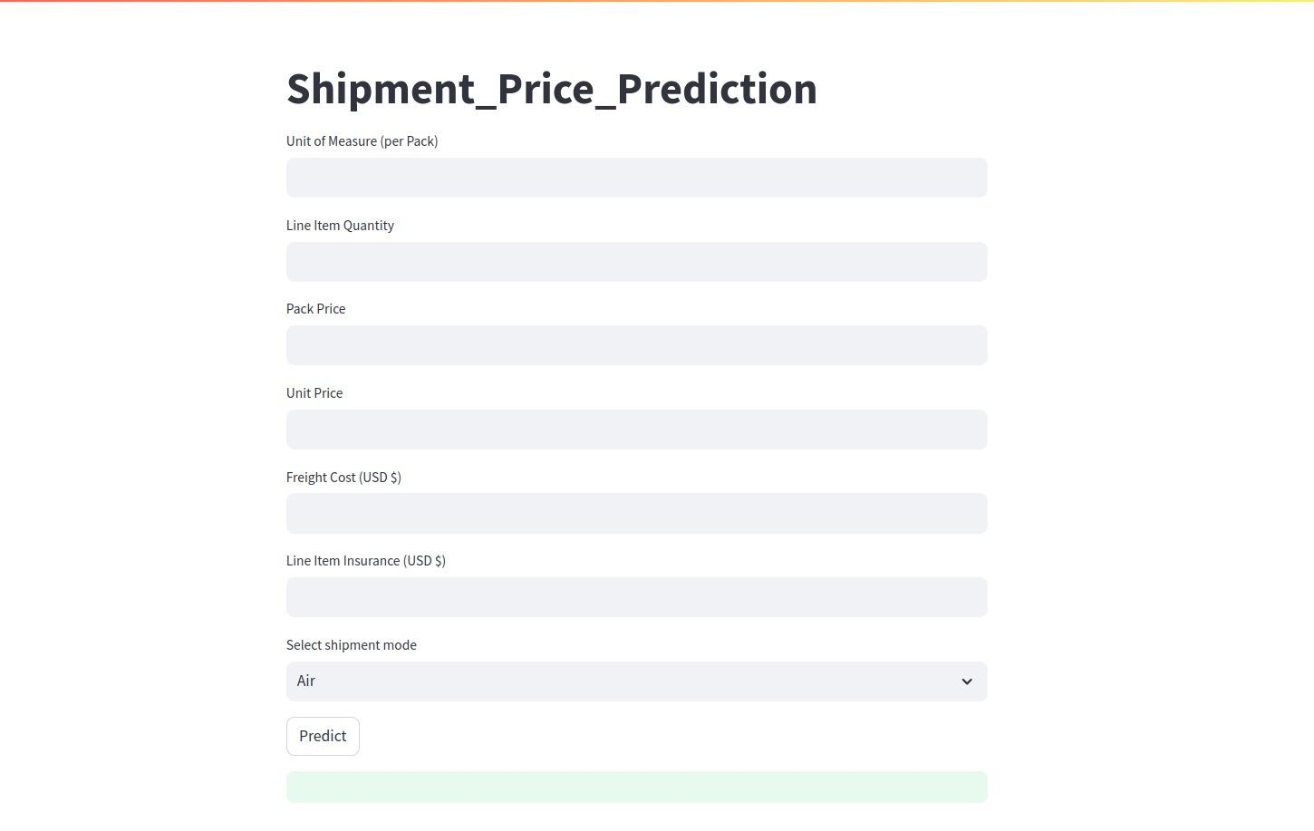

Slide 33
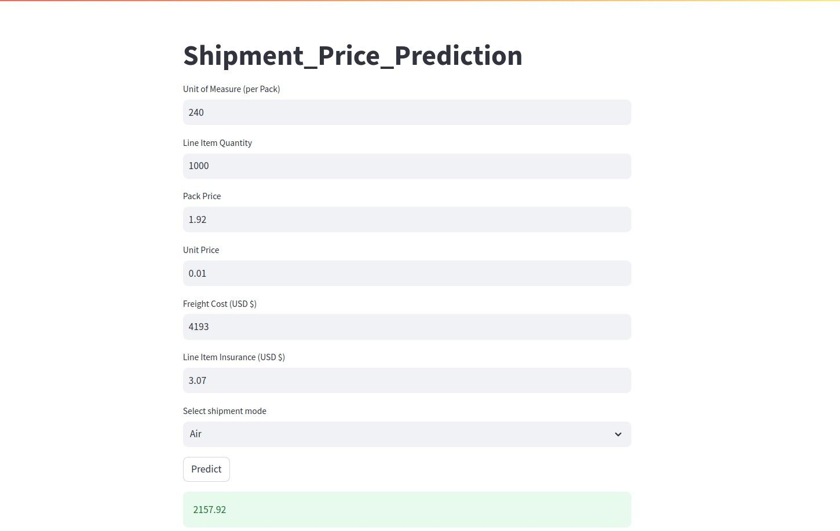

Slide 34
Conclusion
AI's transformative impact is compelling organizations to embrace advanced solutions. Our project unveils AI-driven price forecasting for supply chains, offering vast potential to enhance logistics and supply chain management globally.

Slide 35
11
References

Slide 36
References
https://www.linkedin.com/posts/mohamed-illiyas_supply-chain-shipment-pricing-forecasting-activity-6880766053572599808-zu0R/
https://journalofbigdata.springeropen.com/articles/10.1186/s40537-020-00329-2
https://aws.amazon.com/blogs/apn/optimizing-supply-chains-through-intelligent-revenue-and-supply-chain-iras-management/
Forecasting the Spot Price of P1A Shipping Route | IEEE Conference Publication | IEEE Xplore
https://www.sciencedirect.com/science/article/abs/pii/S0377221706012057

Slide 37
Thank
You

